Slide 1


INDUSTRY,INNOVATION AND INFRASTRUCTURE

Slide 2

REASONS FOR LACK OF INDUSTRIAL INNOVATION :
Innovation demands long-term investments and to be sustainable it depends on the market’s ability to encourage and pay a premium.
The industrial eco-system in India is focussed on design and not much of research beyond it.
No gather of teams , brainstorm idea, building of prototype , quality testing are the reasons for losing momentum towards completion.
They are not able to understand what their costumers really need.

Slide 3

REASONS FOR LACK OF STUDENT INNOVATION
Because of more theoretical practice than practical approach to which students can understand.
No proper funds provided to them to continue their research work.
Encouragement is not provided regarding research work .
lack at arranging industrial interactions for their students such as those in US , which render solid industry exposure.

Slide 4
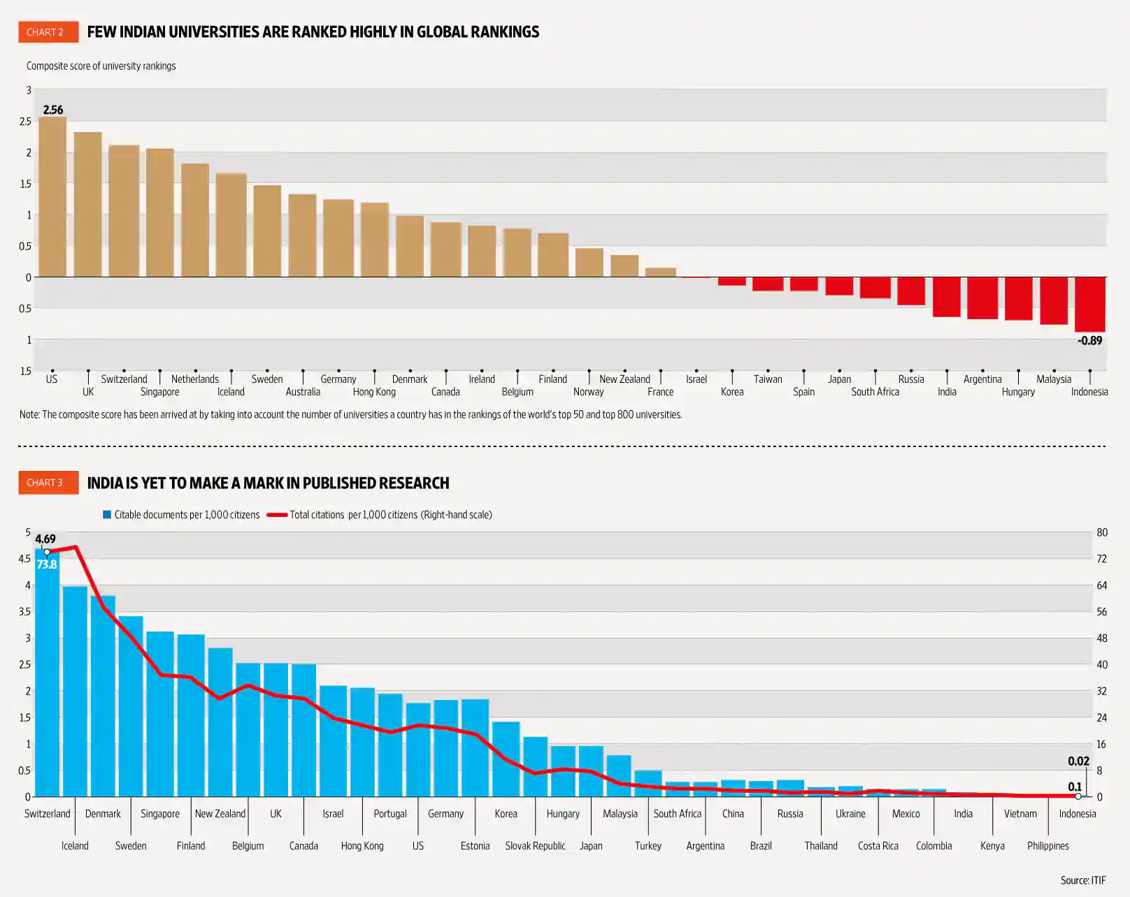
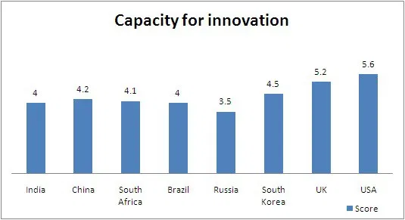
MAJOR OBSTACLES FACED BY INDIA IN EDUCATIONAL SECTOR IS :
Research and innovation

Slide 5

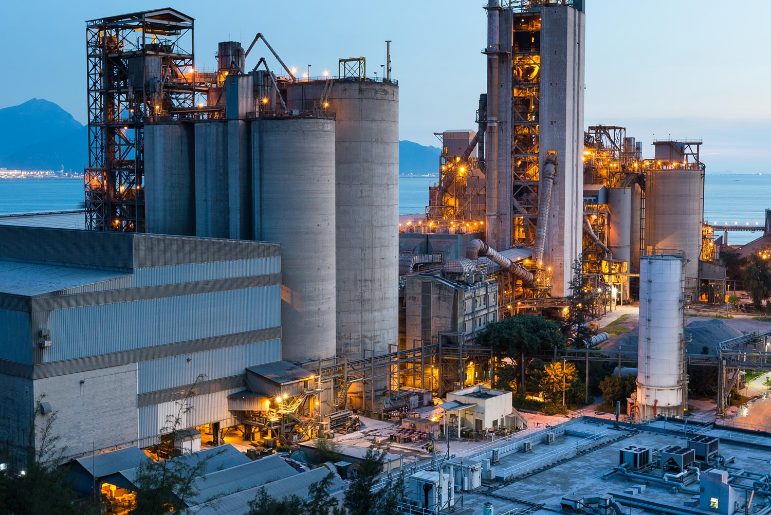
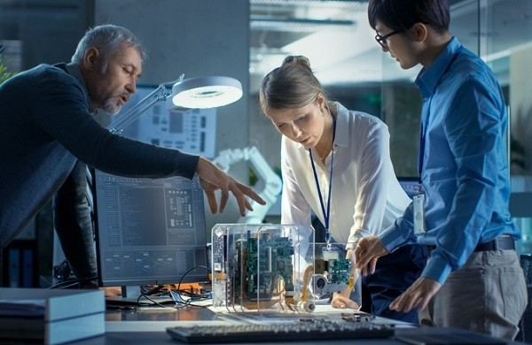
OUR MAIN THEME IS TO CONNECT INDUSTRIES WITH STUDENTS IN THE COUNTRY .
WITH REAL TIME EXPERIENCE , INNOVATION, RESEARCH , ENTERPRENEURSHIP

Slide 6
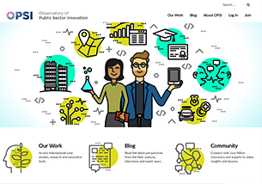
CONNECTING INDUSTRIES AND STUDENTS
Better interaction between Technical Institutions and Industry is the need of the hour.
These objectives can only be achieved well by bridging the gap between industry and the students
The students should be introduced to practical hand on experience and encouraged to take up the small projects with their application in real world.
Industry institute interaction opens new avenues for entrepreneurship among engineers.
It gives them a platform for generating ideas and opportunity to reciprocate them into feasible business venture

Slide 7
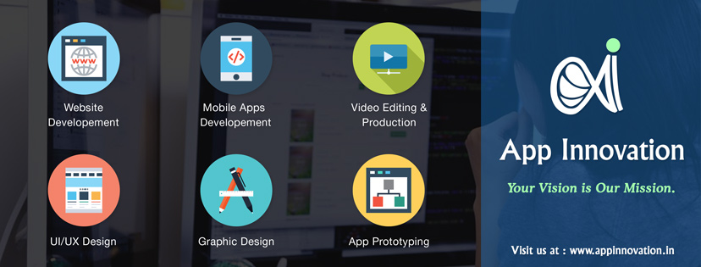
Connecting industries and students through our app
Uses of our app :
This platform help the students with innovative ideas to present them instead of waiting for support or hoping for funds.
Industries can get a better platform to find there needs and take them directly from innovator instead of a long process of searching them going through various platforms for each.
The students who don’t have an innovative ideas can also take up a project from our app and contribute to industries.
Even students from different places can interact with each other to do research work.
Features :
innovative videos can be uploaded.
Rating can be given to the innovation.
Mentors can suggest students in their research work.
Coins system also we can find in this app.

Slide 8
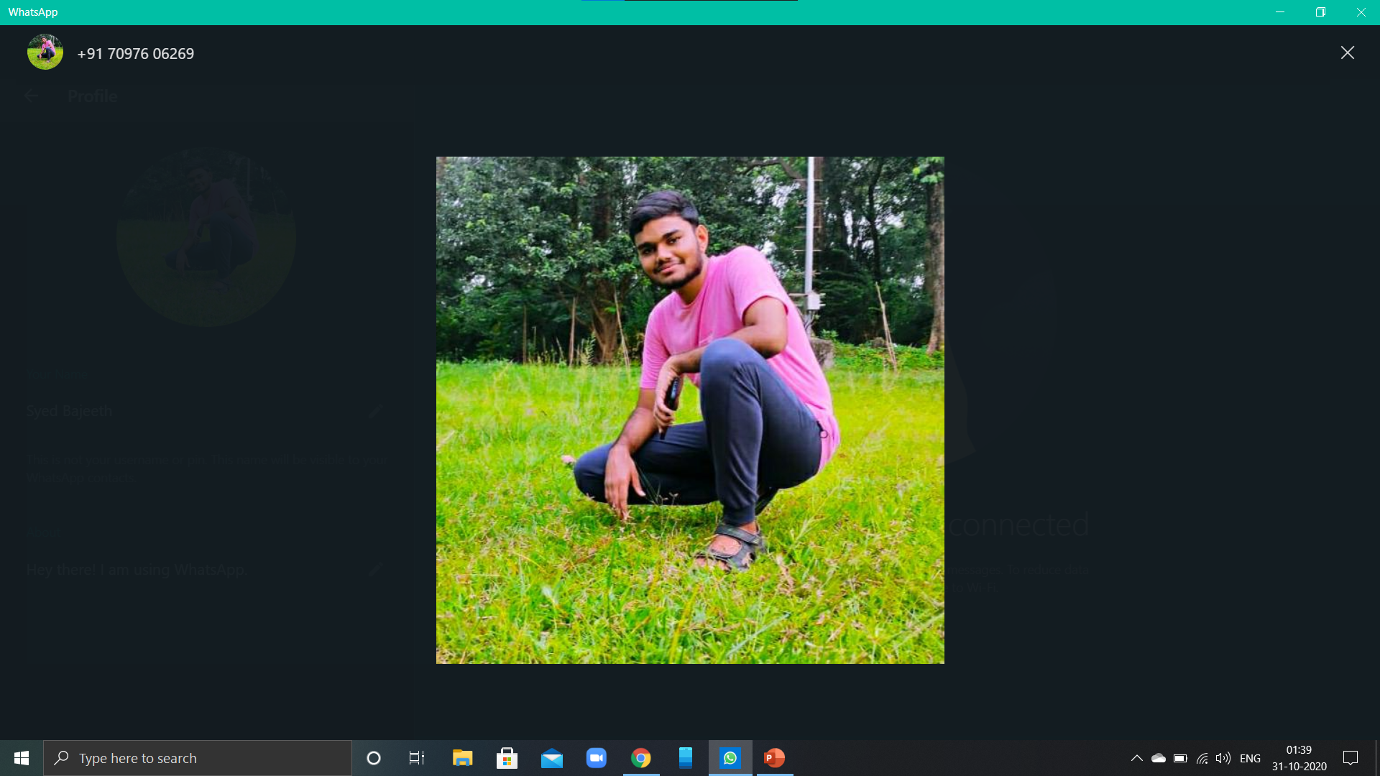
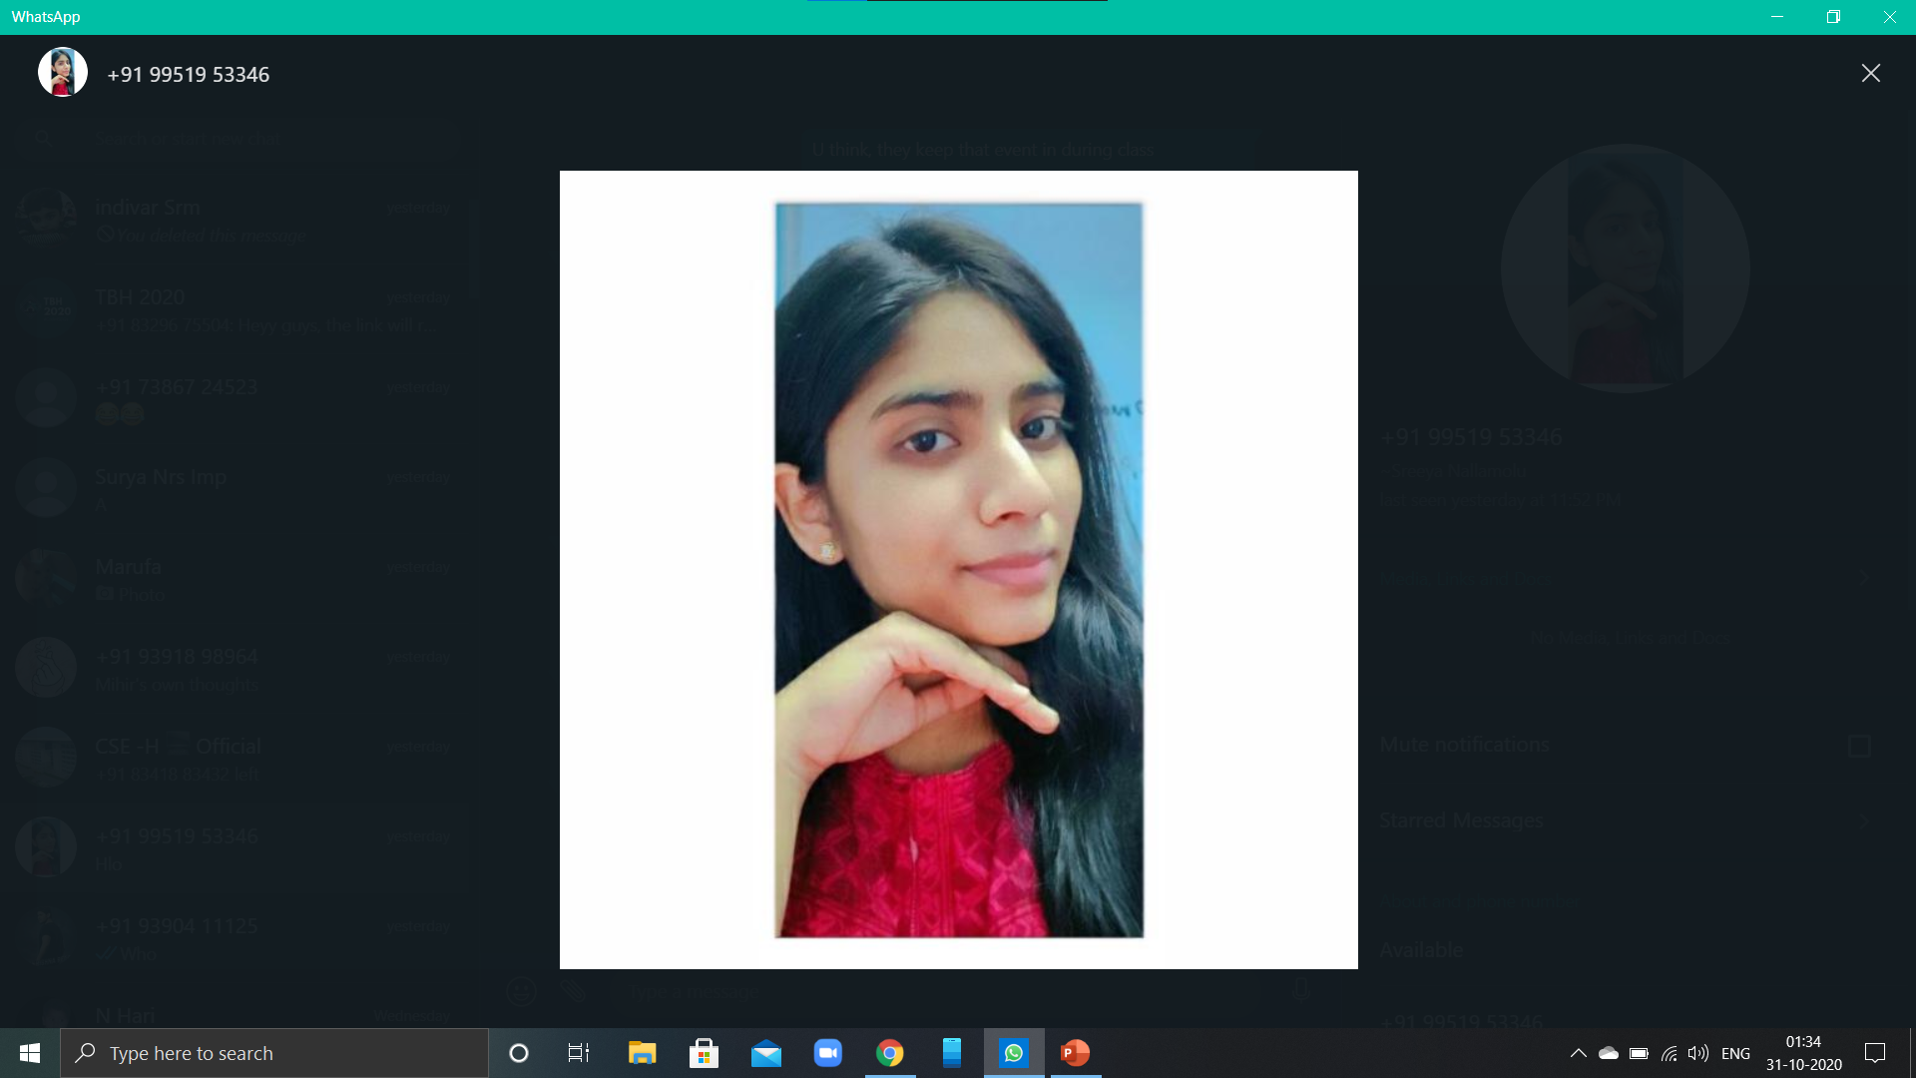

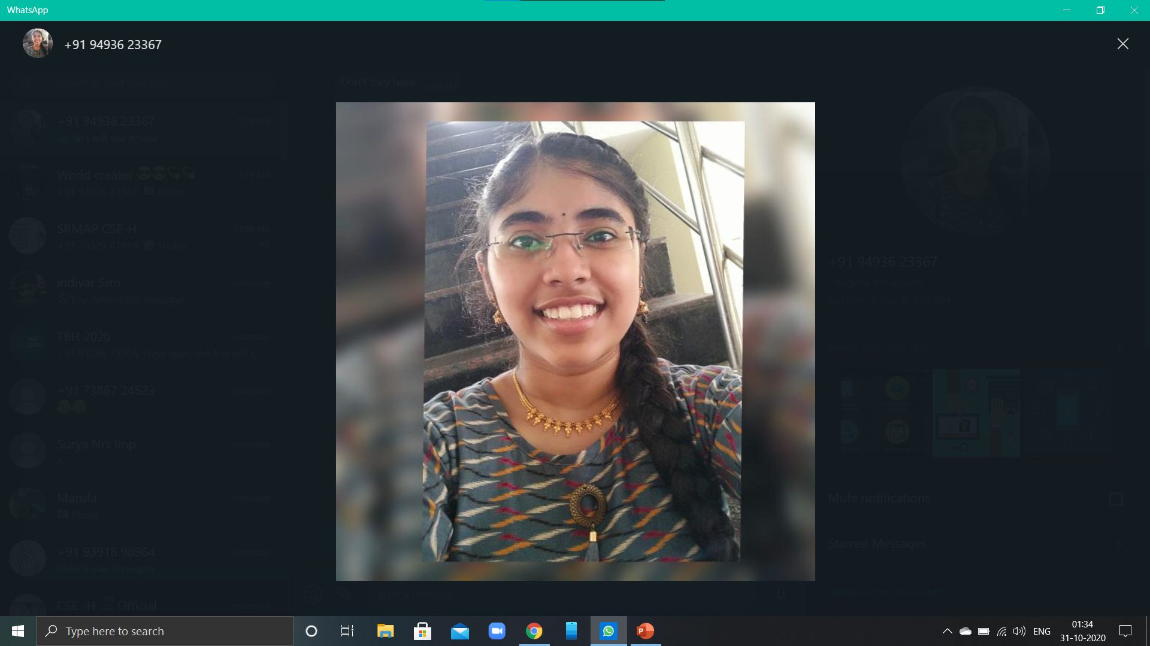
team
SYED BAJEETH
SREEYA NALLAMOLU
APPALA INDIVAR YUVARAJ
YOGITHA YARLAGADDA
SRM UNIVERSITY ,
AMARAVATI
SRM UNIVERSITY,
AMARAVATI
SRM UNIVERSITY,
AMARAVATI
SRM UNIVERSITY,
AMARAVATI

Slide 9
Thank you
yogitha_yarlagadda@srmap.edu.in

